Slide 1
Cell Reports
Volume 43, Issue 3, 26 March 2024, 113909
Article
The Idesia polycarpa genome provides insights into its evolution
and oil biosynthesis
Notes:
We know the pathway by which the oil is created within the plant in question. However, a correct reference genome was needed, in order to perform proper genomic, transcriptomics etc, in the future.

Slide 2
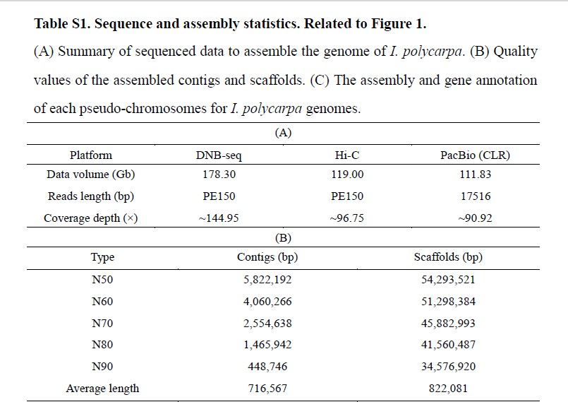
Notes:
Often, to ensure the highest level of accuracy in obtaining a good genome sequenced, is to use multiple different sequencing methods; thereby cancelling out the disadvantages of each methodology.
First thing to look at is the coverage depth, these examples have very high sequencing integrity; add all of the coverage depths together, >300x.
N50: Used to calculate the quality of contigs, using the average size of contigs within the assembly, the N50 is the median size of bases that are allocated into a total of contigs. It concerns the distribution of sequenced bases within the assortment of contigs.
A high N50 and therefore high scaffold number, equate to a good reconstruction.

Slide 3
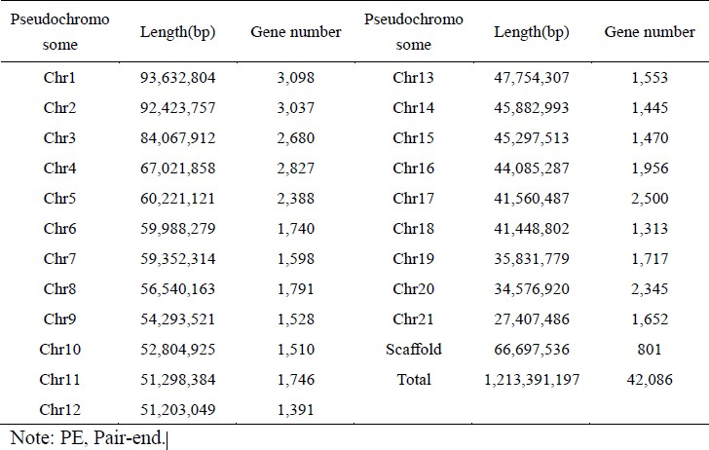
Notes:
A pseudo chromosome is a massive sequence made up during sequence reconstruction, which is a representation of the hypothetical number of chromosomes; if we sequence an organism which we know has 21 chromosomes, if there are 21 instances of very large, nearly complete sequences, these are your pseudo chromosomes.
Chromosomal differences in size indicate heterogeneity in the genetic material; complexity.
Using the after sequencing length, you can compare it to the non specific length analysis during sequencing. Therefore, you can calculate the coverage using these two distinct numbers. (bases can be missed, sequencing errors etc.)

Slide 4
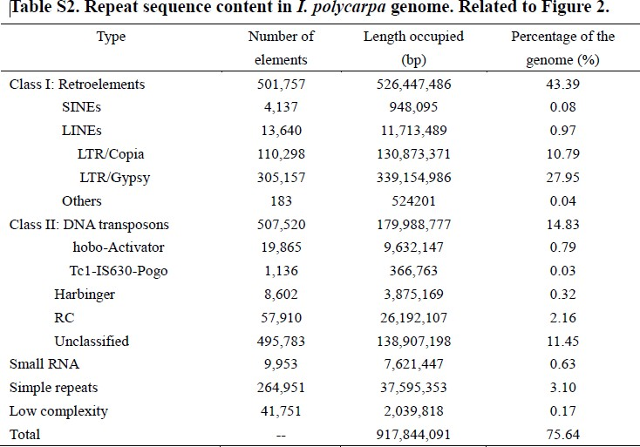
Notes:
From this data we can surmise that Gypsy and Copia are the most important retroelements (retrotransposons), most impactful.
These retroelements are therefore the leading cause for the genome size increase. NOT the repetitive sequences.
So when comparing the genome of I polycarpa, we know the cause behind its comparatively larger size.

Slide 5
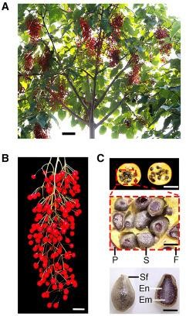
Figure 1. I. polycarpa morphology and genomic landscape
General morphology of a representative I. polycarpa
tree at the fruit stage. Scale bar: 40 cm.
A ripe I. polycarpa spike. Scale bar: 3 cm.
Cross-sections of representative I. polycarpa fruit and seeds. Top, fruit cross-section. The region outlined in dashed red is enlarged in the middle. Scale bar: 6 mm. Middle, enlarged image of the pericarp and seeds. Scale bar: 2 mm. Bottom, a coated seed intact (left) and in cross- section (right). Scale bar: 1 mm. P, pericarp; S, seed; F, flesh; Sf, seed film; En, endosperm; Em, embryo.

Slide 6
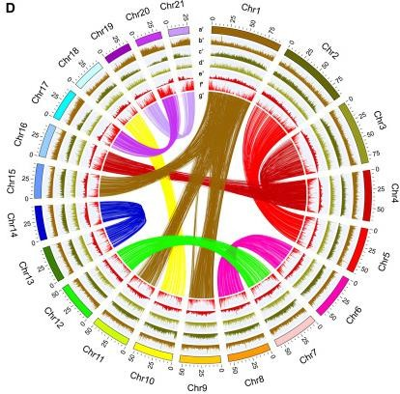
Figure 1. I. polycarpa morphology and genomic
landscape
(D) Summary of the I. polycarpa genomic landscape. (a′) Length of each pesudochromosome in megabases (Mb). (b′) CG content (28%–35%).
(c′) Number of repeat element (100–500). (d′) Number of Copia elements (0–72). (e′) Number of Gypsy elements (0–221). (f′) Number of genes (30– 500). (g′) Syntenic blocks in homologous chromosomes. Each line represents a block longer than 2 kb. All data were based on 200-kb windows.
Notes:
GC content is not homogenous in the genome, different chromosomes exhibit altering levels of GC.
Repetitive elements are also not homogeneously distributed along the genome, heterogeneity.
Some chromosomes have more specific clusters of Gypsy elements. Copia elements are more equally distributed.
With more genes, or rather higher density of genes, there will be a smaller amount of transposable elements.
Centromeres for example are highly dense in retrotransposons, but have barely any genes.
The genome as one can observe, has two copies of genes, across the genome. Therefore, one can say that there must have been a whole genome duplication during the organism’s evolution, diploidy.

Slide 7
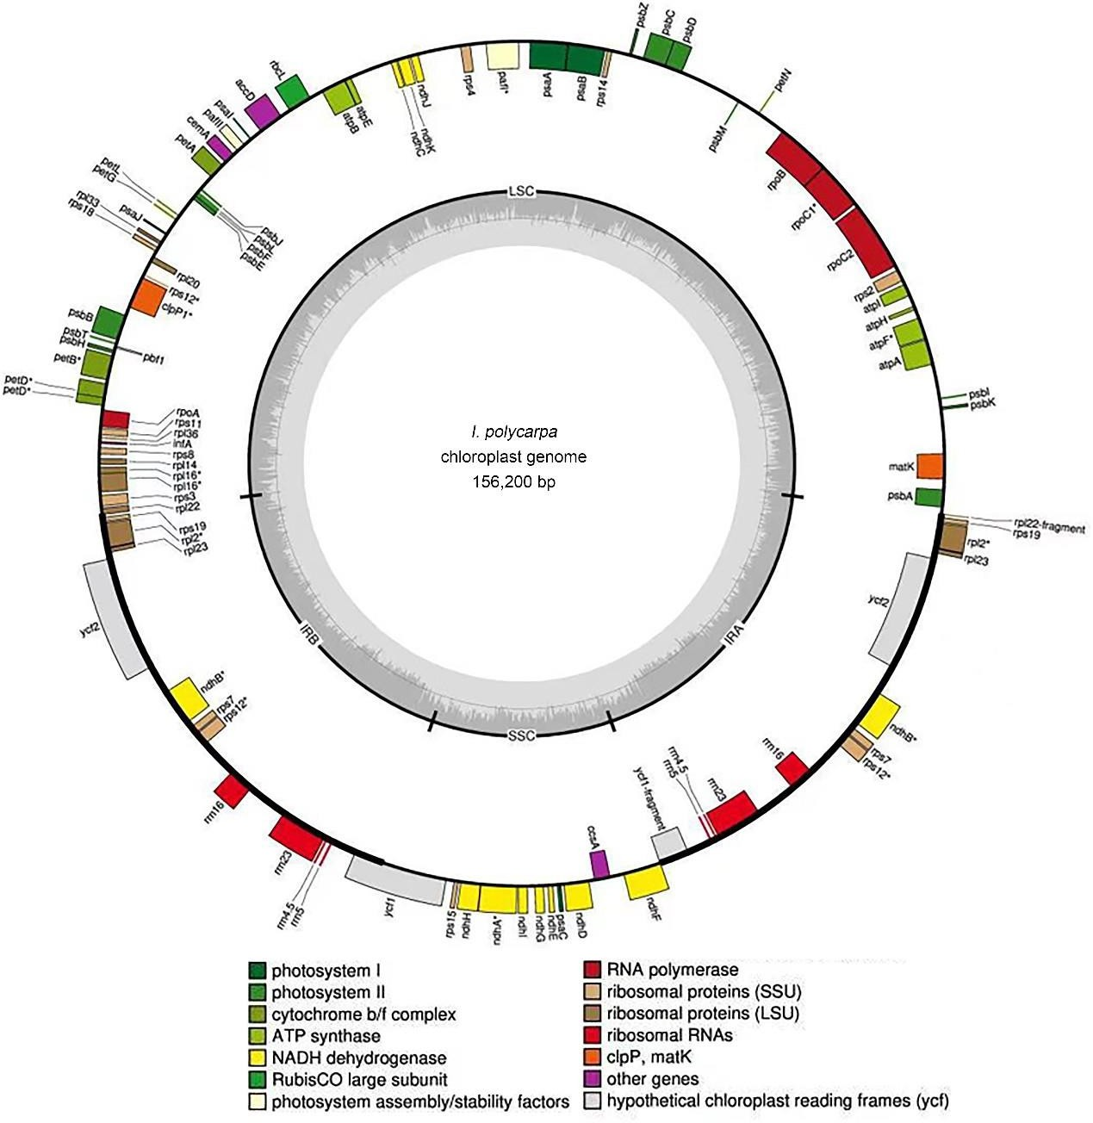
Figure S2. Chloroplast reference genome of I. polycarpa. Related to Figure 1.
The localization and function of the annotated genes are illustrated in the outer circle.
GC content is graphed around the inner circle with the line indicating 36.79% GC content. The map was generated using OrganellarGenomeDraw.
Notes:
Observe the annotations in the gray inner circle, these regions are annotated specifically;
SSC, single copy region, the part of the genome which is only present once.
IRB and IRA; inverted repeat-“genomes”, collection of inverted repeats.
LSC;
Boxes on the inside and outside of the outer circle, represent genes. They can only be on one side of the outer circle.

Slide 8
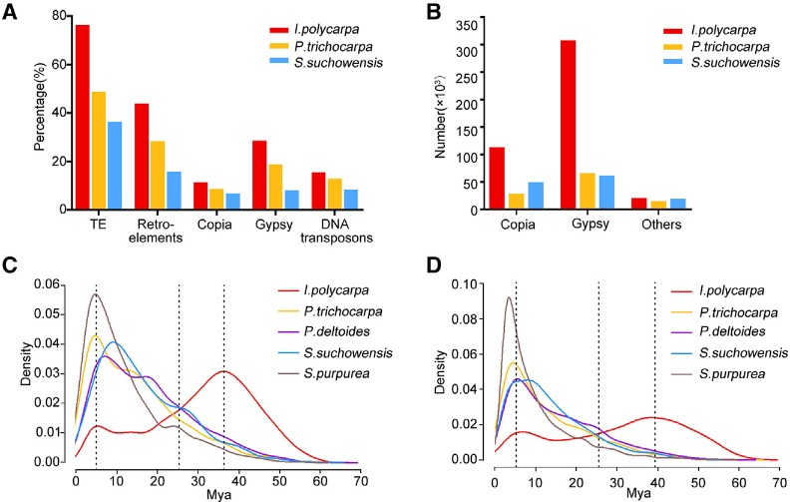
Figure 2. Characteristics of Copia and Gypsy retroelements in I. polycarpa and other woody plants in the family Salicaceae
(A) Distribution of repeat element types in I. polycarpa (red), Populus trichocarpa (yellow), and Salix suchowensis (blue).
(B) The number of intact
in I. polycarpa,
retroelements
P. trichocarpa, and S. suchowensis.
(C and D) Expansion of Copia (C) and
Gypia (D) retroelements in
I. polycarpa and other species in the
family Salicaceae (P. trichocarpa,
S. suchowensis, P. deltoides, and
S. purpurea).
Notes:
One should note from these figures that the TE are important in the speciation of our desired species.
Gypsy elements particularly are of importance. Why so many, where are they inserted, how do they work?

Slide 9
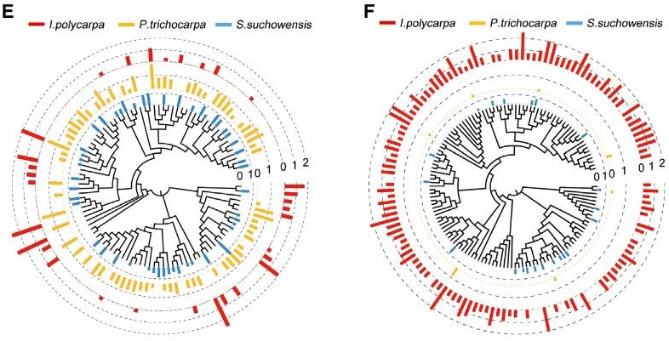
(E and F) Phylogenetic trees showing expanded Copia (E) and Gypsy (F) retroelement families in
I. polycarpa, P. trichocarpa, and S. suchowensis and the number of activated Copia and Gypsy
elements in each. Bars are log₁₀ (numbers).
Notes:
Here they are looking at intact copies of TEs, within families of either Copia or Gypsy. They have reconstructed the phylogeny of the TEs.
Gypsy TEs are most diverse in Polycarpa, whereas the Copia TEs are most diverse in Trichocarpa

Slide 10
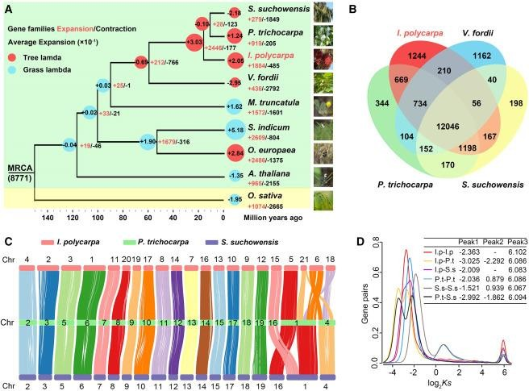
Figure 3. Genome evolution of
I. polycarpa
(A) Phylogenetic tree showing relationships between I. polycarpa,
P. trichocarpa, S. suchowensis, Vernicia fordii, Arabidopsis thaliana, Oryza sativa, Sesamum indicum, Olea europaea, and Medicago truncatula. The red and blue circles represent tree and grass lambda, respectively. The number in each circle represents the average expansion rate (×e−1).
(B) Shared and unique gene families in
I. polycarpa, P. trichocarpa,
S. suchowensis, and V. fordii.
Syntenic comparison of homologous chromosomes in I. polycarpa, S. suchowensis, and P. trichocarpa.
Distribution of the synonymous substitution rate (Ks) among homologous gene pairs in the family Salicaceae.

Slide 11
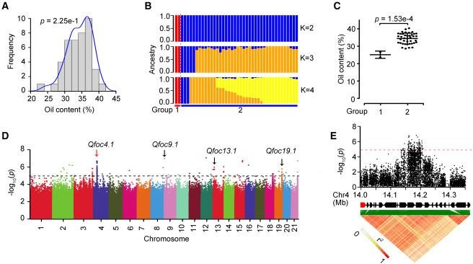
Figure 5. Genome-wide association study (GWAS) of oil content in I. polycarpa
Distribution of oil content among 42 I. polycarpa accessions. The data were normally distributed (p = 2.25e−1, Shapiro-Wilk test).
Genetic structure of the I. polycarpa population (at K = 2–4). All accessions are represented along the x axis, and the proportion of ancestry at each K value is shown along the y axis.
Comparison of oil content between two groups of I. polycarpa accessions. p values were derived from a two-tailed analysis of variance
(ANOVA).
Manhattan plot showing results of the GWAS for oil content. The red arrow indicates the location of peak.
Local Manhattan plot (top) and linkage disequilibrium plot (bottom) for single-nucleotide polymorphisms (SNPs) surrounding the peak on chr4. The location of IpSTP5 is indicated in red.

Slide 12
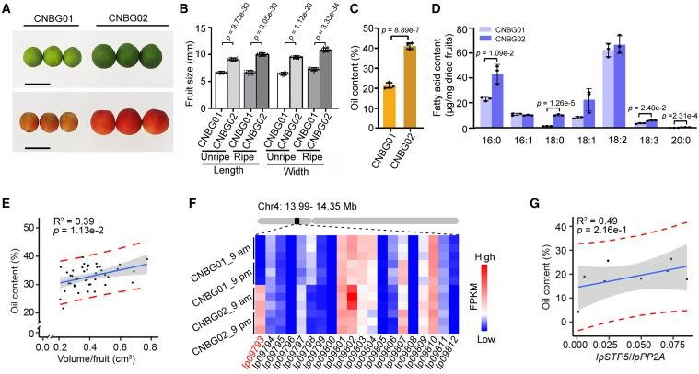
Figure 6. The genetic basis of oil content in I. polycarpa
Fruit phenotypes of two accessions with varying oil content: China National Botanical Garden (CNBG) 01 and CNBG02. Top, unripe fruits at 75 days after pollination (DAP). Bottom, ripe fruits at 127 DAP. Scale bars: 1 cm.
Statistical analysis of CNBG01 and CNBG02 fruit size at the unripe and ripe stages. Values are mean ± SEM (n = 20, p values were derived from ANOVA).
Total oil content of dried fruits measured by Soxhlet extraction as expressed as a percentage (w/w) of total fruit weight. Values are mean ±
SEM (n = 3, p value was derived from ANOVA).
Content of individual fatty acids in dried fruits measured by GC-MS. Values are mean ± SEM (n = 3, p value was derived from ANOVA). Individual species of fatty acids (number of carbons:number of double bonds; 16:0, palmitic acid; 16:1, palmitoleic acid; 18:0, stearic acid; 18:1, oleic acid; 18:2, linoleic acid; 18:3, linolenic acid; 20:0, arachidic acid) are listed on the x axis.
Correlation analysis between fruit volume and oil content in I. polycarpa (R² = 0.39).
Heatmap showing expression of genes located in the candidate region of chr4 identified with a GWAS. Ip09793/IpSTP5, which was
significantly differentially expressed between CNBG01 and CNBG02, is indicated in red text.
Correlation analysis between IpSTP5 expression levels and oil content in I. polycarpa (R² = 0.49).

Slide 13
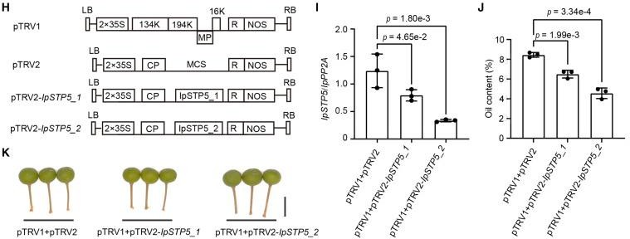
Figure 6. The genetic basis of oil content in I. polycarpa
(H) Map of pTRV1, pTRV2, pTRV2-IpSTP5_1, and pTRV2-IpSTP5_2 vectors used in this study. pTRV2-IpSTP5_1 was cloned from 596 to 1,026 bp, and pTRV2-IpSTP5_2 was cloned from 1,123 to 1,521 bp.
RT-qPCR assay of IpSTP5 expression in unripe fruits after 14 days of inoculation. Values are mean ± SEM (n =
3, p values were derived from ANOVA).
Statistic analysis of the oil content of unripe fruits after 14 days of inoculation. Values are mean ± SEM (n = 3, p values were derived from ANOVA).
The unripe fruit phenotypes after 14 days of inoculation in IpSTP5 VIGS assay. Scale bars: 1 cm.

Slide 14
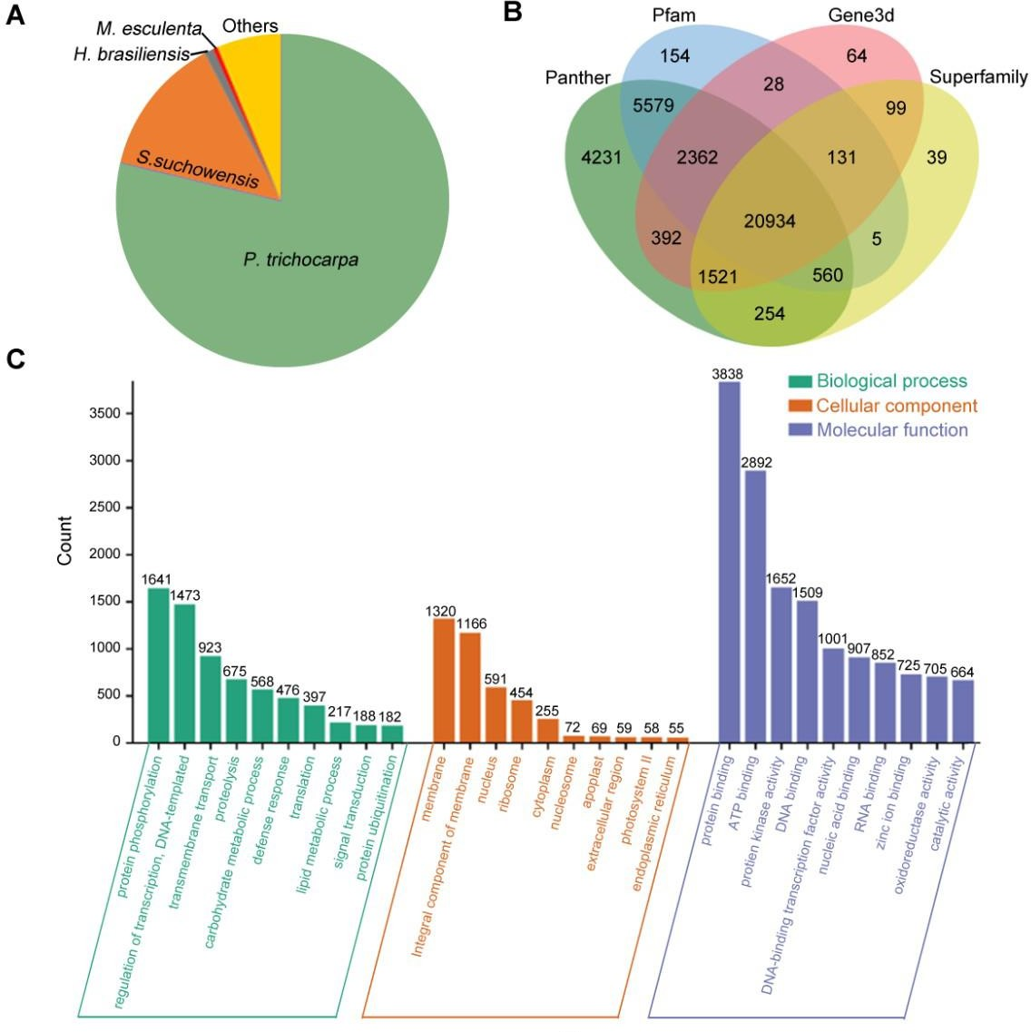
The functional annotation results of I. polycarpa genes by NR (A) and Interproscan (B) databases, respectively. Most of the annotated genes were homologous to genus P. trichocarpa, and then S. suchowensis. (C) The GO terms and the number of genes for each in I. polycarpa genomes.

Slide 15
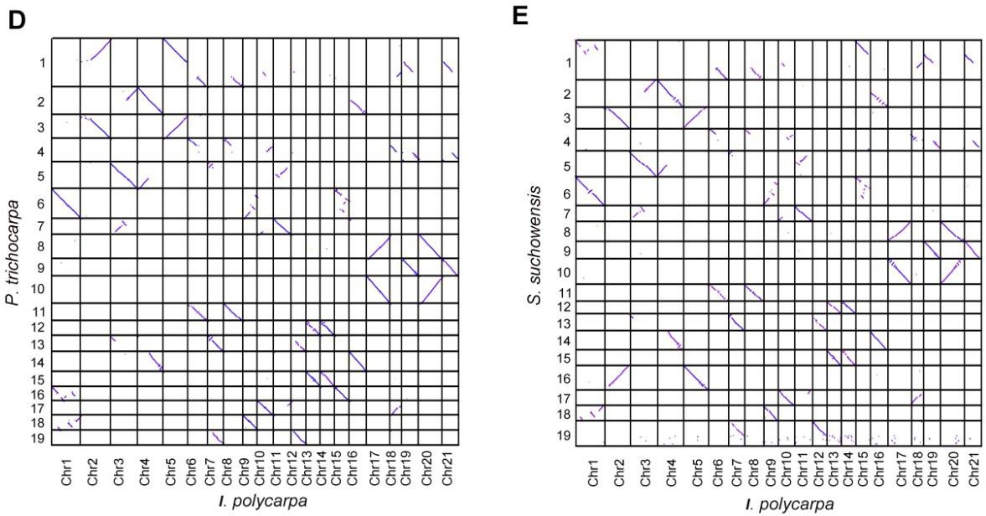
(D) Pattern of synteny between I. polycarpa and P. trichocarpa.. The results displayed 2-to-2 collinearity relationship with minimum length 2 kb. And with minimum length 5 kb, they have a 1-to-1 homologous chromosomes relationship, which displayed the chromosome rearrangement event of their ancestors. (E) Pattern of synteny between I. polycarpa and S. suchowensis

